Slide 1
Ksc6103 data STRUCTURE & algorithm analysis
Lists, Stacks and Queues

Slide 2
CHAPTER CONTENT
Chapter 4: Lists, Stacks and Queues Introduction to ADTs and Lists Linked Lists Singly Linked Lists Doubly Linked Lists Stacks Array-Based Stack Parentheses Matching and HTML Tag Queues Array-Based Queue Circular Queue Deques

Slide 3


CHAPTER LEARNING OUTCOMES
 | Understand the concepts of Lists, Stacks and Queues.
 | Explain the difference between the operations of lists, stacks and queues and their implementation.

Slide 4
INTRODUCTION

Slide 5
ABSTRACT DATA TYPES
An abstract data type (ADT) is an abstraction of a data structure
An ADT specifies:
Data stored
Operations on the data
Error conditions associated with operations

Slide 6
ABSTRACT DATA TYPES (EXAMPLE)
Example: ADT modeling a simple stock trading system
The data stored are buy/sell orders
The operations supported are order buy(stock, shares, price)
order sell(stock, shares, price)
void cancel(order)
Error conditions:
Buy/sell a nonexistent stock
Cancel a nonexistent order

Slide 7
WHAT IS LIST?
A list or sequence is an abstract data type that represents a countable number of ordered values, where the same value may occur more than once.
The list data structure typically has two very distinctive implementations — array list and linked list.

Slide 8
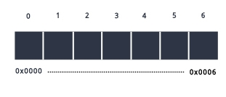
ARRAY LIST

Slide 9
Linked lists

Slide 10
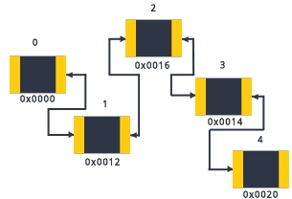
LINKED LISTS
A linked list is a linear data structure which is constituted by a chain of nodes in which each node contains a value and a pointer to the next node in the chain.
Also, the last link in a linked list points to null, indicating the end of the chain.
An element in a linked list is called a node.
The first node in the list is called the head.
The last node is called the tail.

Slide 11
What is List?
Linked Lists
Singly Linked List
Doubly Linked List
A singly linked list is a concrete data structure consisting of a sequence of nodes, starting from a head pointers.
Singly-linked lists have pointers to the next node in the list.
Doubly-linked lists have pointers to both the previous and the next node in the chain.

Slide 12
Singly Linked List
The structure declared for linear linked list holds two members.
An integer type variable ‘data’ which holds the elements and
Another type ‘node’, which had next, which stores the address of the next node in the list.
next
element
node
head
∅
A
B
C
D

Slide 13
Doubly Linked List
Previously, we can insert a node at either end of a singly linked list and can delete a node at the head of a list, but we cannot efficiently delete an arbitrary node from an interior position of the list if only given a reference to that node, because we cannot determine the node that immediately precedes the node to be deleted (yet, that node needs to have its next reference updated).
prev
next
element
node
header
nodes/positions
trailer
elements

Slide 14
Doubly Linked List
We define a linked list in which each node keeps an explicit reference to the node before it and a reference to the node after it. Such a structure is known as a doubly linked list.
A doubly linked list can be traversed forward and backward.
Nodes store:
element
link to the previous node
link to the next node
Special trailer and header nodes

Slide 15
stacks

Slide 16

Stack
A stack is a collection of objects that are inserted and removed according to the last-in, first-out (LIFO) principle.
A user may insert objects into a stack at any time, but may only access or remove the most recently inserted object that remains (at the so-called “top” of the stack).
Two operations are defined on a stack:
Push - Inserting information into the stack
Pop - retrieving information from the stack.

Slide 17
Stack(Example)
Internet Browsers store the addresses of recently visited sites in a stack. Each time a users visits a new site, the address is pushed onto the stack. The browser allows the user to “pop” back to previously visited sites using the “back” button.
Text Editors usually provide an “undo” mechanism that cancels recent editing operations and reverts to former states of a document. This undo operation can be accomplished by keeping text changes in a stack

Slide 18
The Stack Abstract Data Type
Formally, a stack is an abstract data type (ADT) such that an instance S supports the following two methods:
S.push(e): Add element e to the top of stack S.
S.pop(): Remove and return the top element from the stack S; an error occurs if the stack is empty.
Additionally, let us define the following accessor methods for convenience:
S.top(): Return a reference to the top element of stack S, without removing it; an error occurs if the stack is empty.
S.is_empty(): Return True if stack S does not contain any elements.
len(S): Return the number of elements in stack S; in Python, we implement this with the special method __len__ .

Slide 19
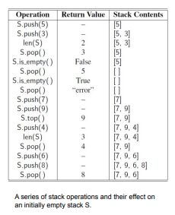

Slide 20
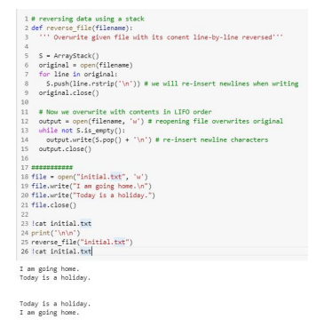
Reversing Data using a Stack
As a consequence of the LIFO protocol, a stack can be used as a general tool to reverse a data sequence.
Examples
printing lines in a file in reverse order.
Reverse the elements of a list using a stack.
Reversing the order in which elements are stored in a stack.

Slide 21
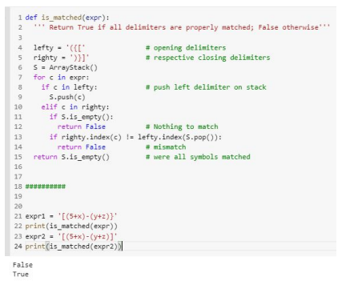
Matching Parenthesis
Perform a left-to-right scan of the original sequence, using a stack S to facilitate the matching of grouping symbols.
Each time an opening symbol encounter, we push that symbol onto S.
Each time we encounter a closing symbol, we pop a symbol from the stack S (assuming S is not empty), and check that this forms a valid pair with the corresponding opening symbol.
If we reach the end of the expression and the stack is empty, then the original expression was properly matched.
Run-time complexity is O(n).
Expression having n characters will make n calls to push and n calls to pop. These calls run in O(n) time.
Selection of possible delimiters has fixed size providing constant time for commands: c in lefty, righty.index(c)

Slide 22
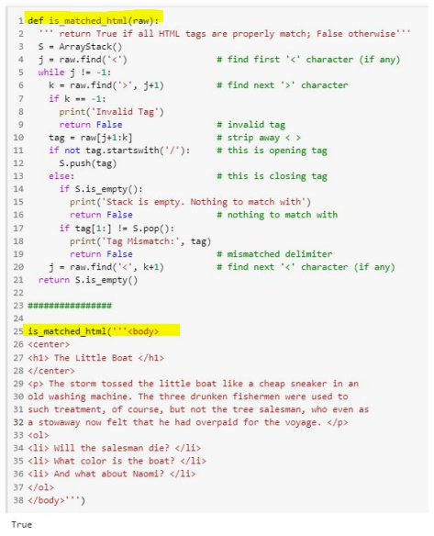
Matching Tags in a Markup Language
Adjoining code demonstrates the use of stacks in checking for matching tags in a HTML document.

Slide 23
queues

Slide 24
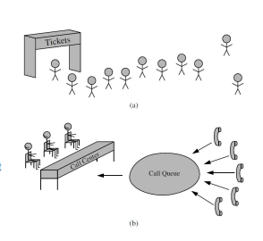
Queues
It is a close “cousin” of the stack.
A queue is a collection of objects that are inserted and removed according to the first-in, first-out (FIFO) principle.
The elements can be inserted at any time, but only the element that has been in the queue the longest can be next removed.
Examples:
People waiting to get on an amusement
park ride.
Phone calls being routed to
a customer service center.

Slide 25
The Queue Abstract Data Type
Formally, the queue abstract data type defines a collection that keeps objects in a sequence, where element access and deletion are restricted to the first element in the queue, and element insertion is restricted to the back of the sequence.
In other words, FIFO rule is enforced on the sequence.
The queue ADT supports two fundamental methods for a queue Q:
Q.enqueue(e): Add element e to the back of queue Q.
Q.dequeue(): Remove and return the first element from queue Q; an error occurs if the queue is empty.
Additional accessor methods:
Q.first(): Return a reference to the element at the front of queue Q, without removing it; an error occurs if the queue is empty.
Q.is_empty(): Return True if queue Q does not contain any elements.
len(Q): Return the number of elements in queue Q; in Python, we implement this with the special method __len__ .

Slide 26
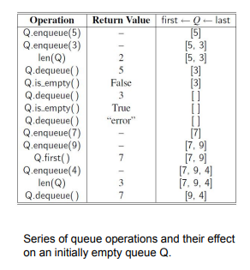
The Queue Abstract Data Type
By convention, we assume that a newly created queue is empty.
There is no a priori bound on the capacity of the queue.
Elements added to the queue can have arbitrary type.

Slide 27

Array-based Queue Implementation (1)
Use append(e) to add elements at the end of the list.
Use pop(0) to remove the first element from the list when dequeuing.
Inefficient implementation with time O(n) time.

Slide 28
Array-based Queue Implementation (2)
Same method for adding elements
Replacement of pop(0) implementation:
Replace the dequeued entry in the array with a reference to None.
Maintain an explicit variable f to store the index of the element that is currently at the front of the queue.
O(1) run-time.
But O(m) space requirement for n elements where m > n, where m is the number of enqueue operations and n is the actual number of elements in the queue.
In other words, a queue with a fewer elements will be stored in a large array

Slide 29
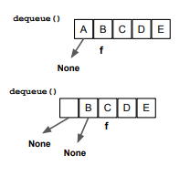
Array-based Queue Implementation (2)
This design would have detrimental consequences in applications in which queues have relatively modest size, but which are used for long periods of time.
For example, the wait-list for a restaurant might never have more than 30 entries at one time, but over the course of a day (or a week), the overall number of entries would be significantly larger.

Slide 30
A Python Queue Implementation
Internally, the queue class maintains the following three instance variables:
_data: is a reference to a list instance with a fixed capacity.
_size: is an integer representing the current number of elements stored in the queue (as opposed to the length of the data list).
_front: is an integer that represents the index within data of the first element of the queue (assuming the queue is not empty).
We provide the following accessor functions:
len(): Current Queue length
is_empty(): Check if the queue is empty ○ first(): return the element at the front of queue
Mutator functions:
enqueue(): To add element into the queue
dequeue(): To remove element from the queue

Slide 31

Adding and removing element
Index where the next element is added to the queue:
During dequeuing, the value at index self._front is returned and removed. The _front index is updated to next position in the circular queue.

Slide 32
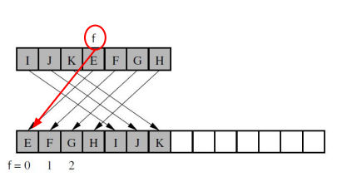
Resizing the Queue
When queue size equals the size of the underlying array, the storage capacity of the underlying list is doubled.
The references from the old list is copied into the new list.
While transferring the contents, we intentionally realign the front of the queue with index 0 in the new array.

